Slide 1
Weekly Progress Report – Construction Projects
Projects Department

Slide 2
Disclaimer
This report is not all inclusive, nor it is intended to address the entirety of construction progress. It is concerned primarily with construction progress and is intended to provide near term management information. The report itself serves as the Agenda for the weekly/Biweekly/Monthly or as required progress meetings.

Slide 3
Introduction

Slide 4
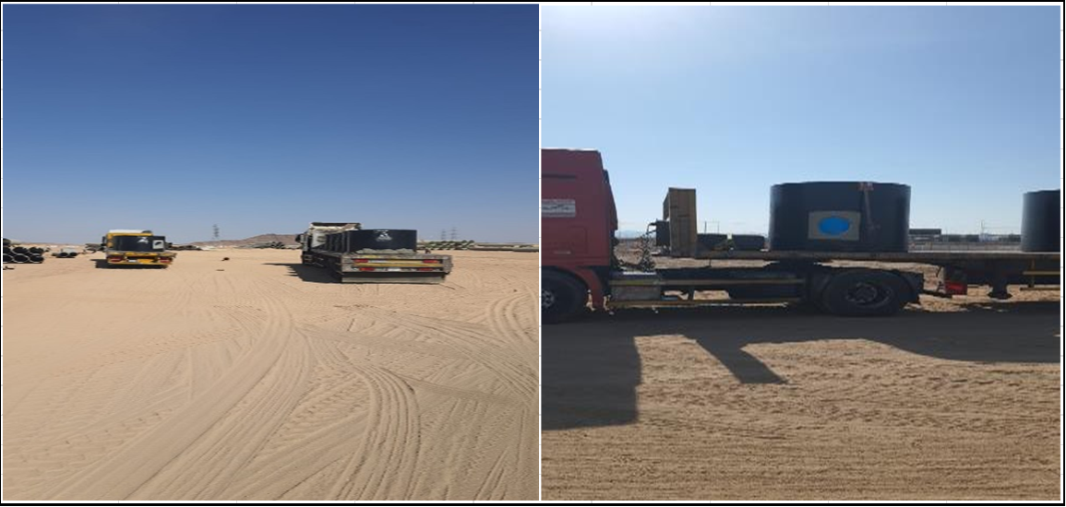
Weekly Progress Report Dashboard

Slide 5
Progress Overview
مجموعة اﻳﺠﺲ لإدارة المشاريع | إستشاري المشروع | الانشاء المتقدم للمقاولات | مقاول المشروع
16-Dec-2026 | تاريخ نهاية المشروع التعاقدية | 17-Feb-2026 | تاريخ بداية المشروع
71.17% | نسبة الانجاز الفعلى بالمشروع | 84.19% | النسبة المستهدفة (طبقا للبرنامج الزمنى التعاقدي)
Project Progress | Planned % | Actual %
 | 84.19 % | 71.17 %

Slide 6
Weekly Progress Report Attachment
Weekly Progress Report Attachement
Contractor/Consultant should ensure that the weekly progress report are supported with required attachment.
Those attachment should include the following as a minimum requirement:
Approved Primavera P6 Schedule in .xer format.
3-5 latest progress photographs in JPG format
Updated Primavera P6 schedule in .xer format & PDF Format Three weeks look ahead in PDF format. (as per plf link)
Remaining Works in PDF format.
Any other supporting document required per the development of the project.

Slide 7
Weekly Report Areas / Sections

Slide 8
Weekly Report Areas / Sections
Contract General Information
HSE
Key Dates
Invoices
Progress Overview
Contract Change Order Log
Construction Milestones
Major Quantity Trackers
Submittals Status
Resources at Site
Shop Drawing Status
Primavera P6 Schedule Status
Material Approval Status
Testing And Commissioning
Quality
Top Issues

Slide 9
Weekly Report Areas / General Information
Contract General Information

Slide 10
Weekly Report Areas / Dates
Key Dates

Slide 11
Weekly Report Areas / Dates
Key Dates

Slide 12
Weekly Report Areas / Progress
Progress Overview

Slide 13
Weekly Report Areas / Progress
Progress Overview

Slide 14
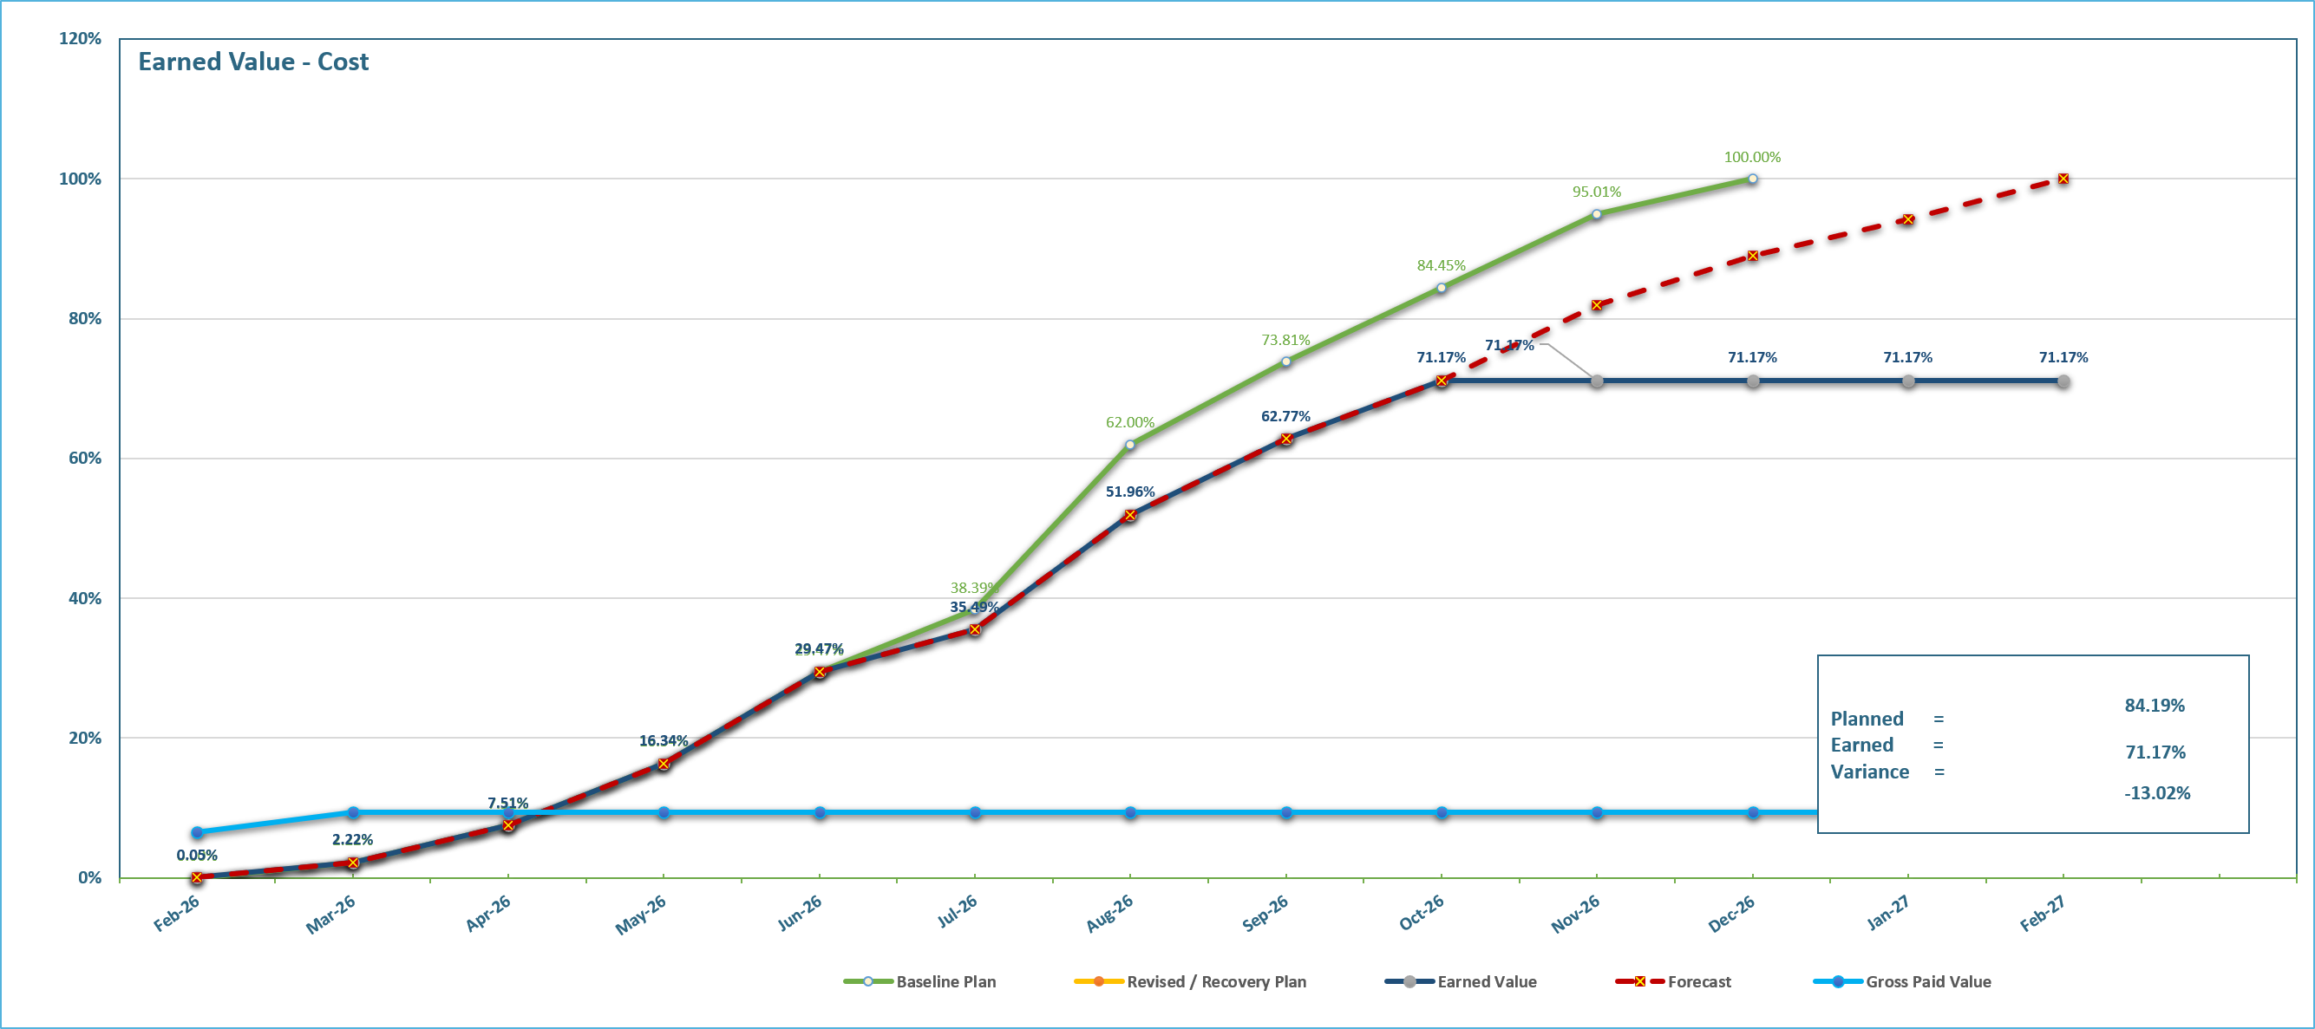
Weekly Report Areas / Progress
Progress Overview

Slide 15
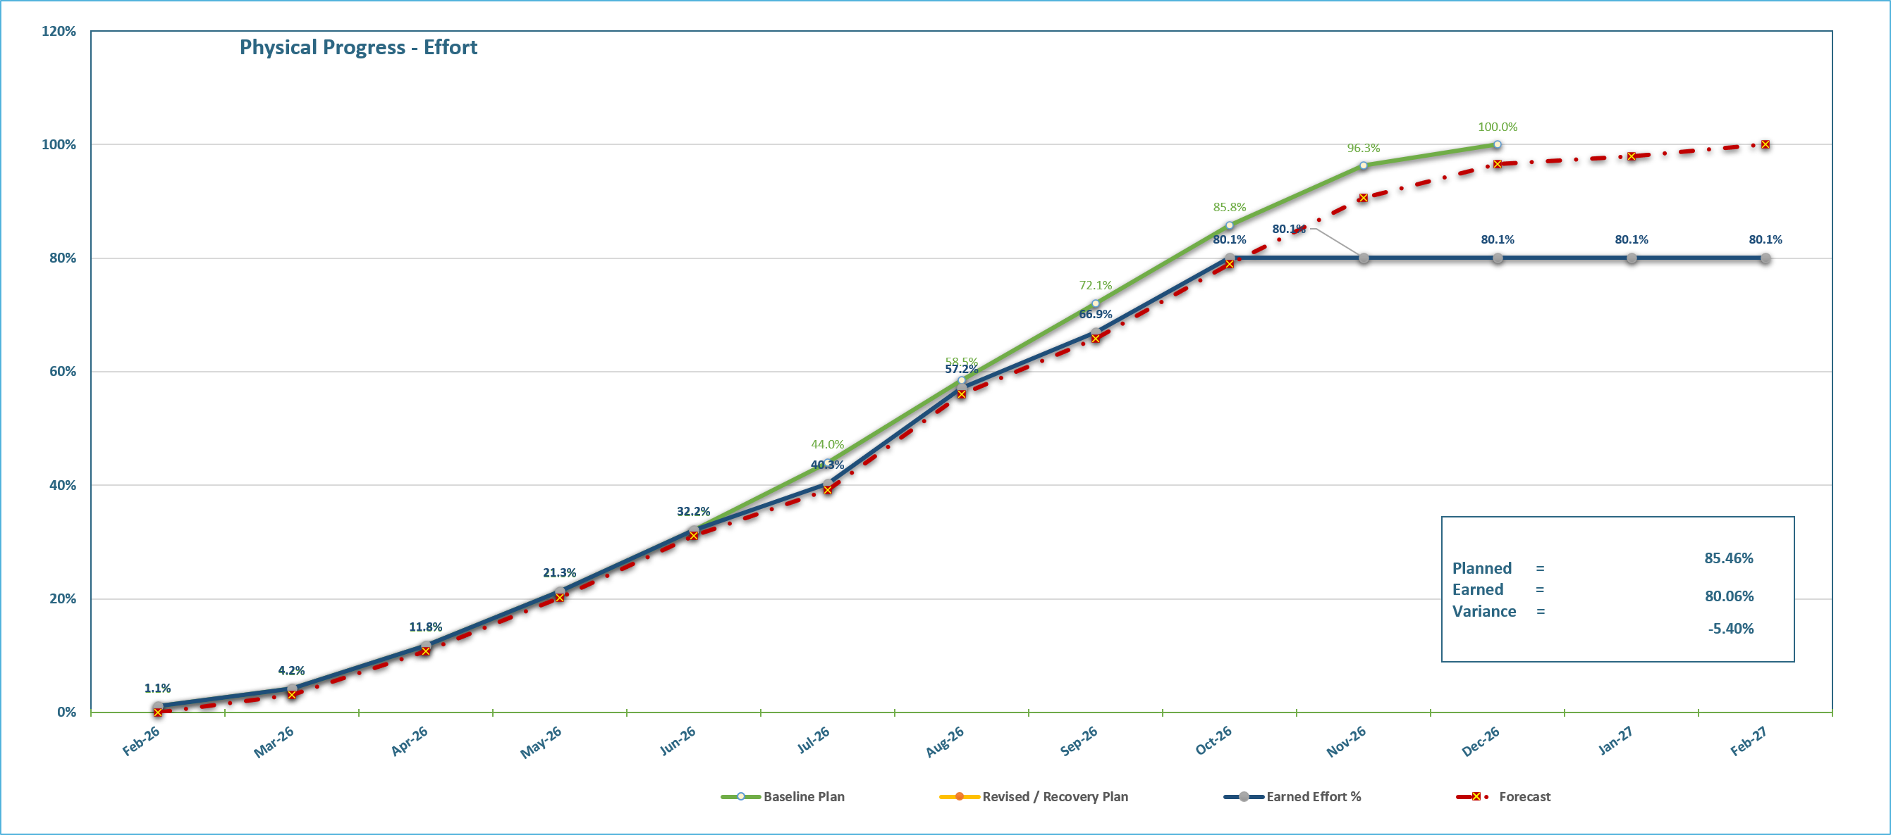
Weekly Report Areas / Progress
Progress Overview

Slide 16
Weekly Report Areas / Milestones
Construction Milestones

Slide 17
Weekly Report Areas / Shop Drawings
Shop Drawings

Slide 18
Weekly Report Areas / Material Approval
Material Approval

Slide 19
Weekly Report Areas / Quality Reports
Quality Reports

Slide 20
Weekly Report Areas / Invoices Summary
Invoices Summary

Slide 21
Weekly Report Areas / Quality
Quality Audit

Slide 22
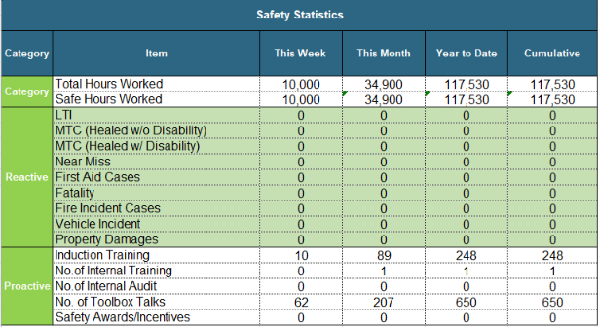
Weekly Report Areas / HSE
Health, Safety & Environmental (HSE)

Slide 23
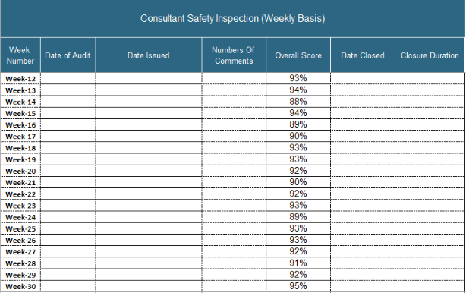
Weekly Report Areas / HSE
Health, Safety & Environmental (HSE) Audits

Slide 24
Weekly Report Areas / Invoices
Invoice Log

Slide 25
Weekly Report Areas / Invoices
Invoice Summary

Slide 26
Weekly Report Areas / CCOs
Contract Change Orders (CCOs)

Slide 27
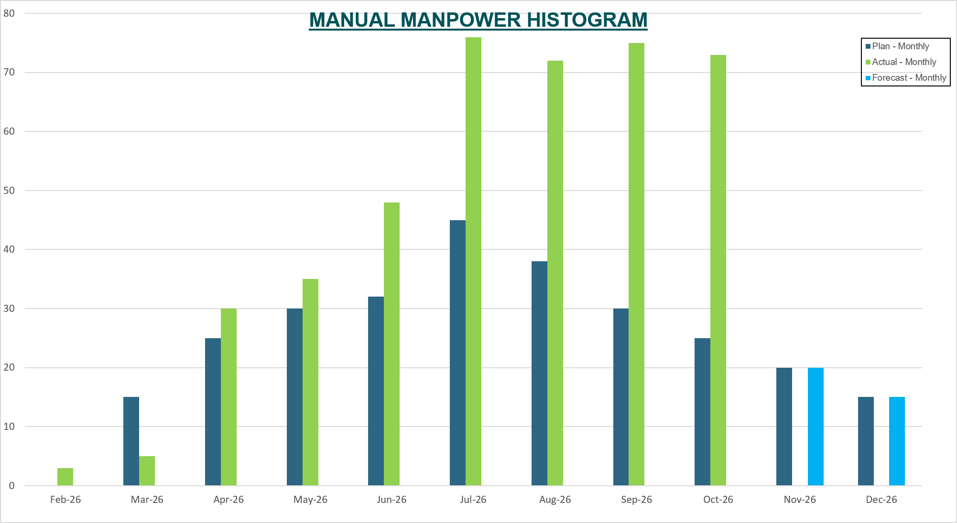
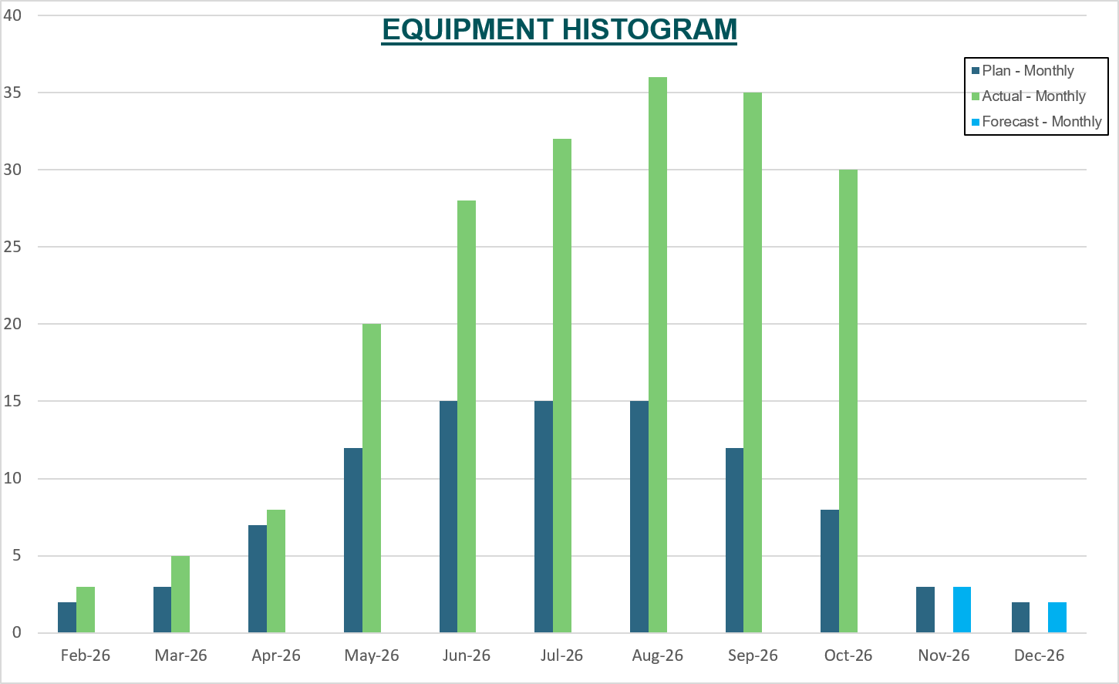
Weekly Report Areas / Resources
Resources

Slide 28
Weekly Report Areas / Schedule Status
Primavera P6 Schedule Status

Slide 29
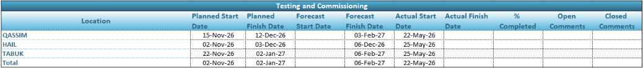
Weekly Report Areas / Testing and Commissioning
Testing And Commissioning

Slide 30
Weekly Report Areas / Issues
Active Issues

Slide 31
شكراً

